Slide 1
Full-Waveform adjoint moment tensor inversion
Azhar Harisandi - 22320011
Pembimbing :
Dr. rer. nat. David P. Sahara
Dr. rer. nat. Andri Hendriyana
Faculty of Mining and Petroleum Engineering
Department of Geophysical Engineering

Slide 2
Outline
Full Waveform Inversion technology
Forward and Adjoint simulation
Preliminary result in our group

Slide 3
Full Waveform Inversion

Slide 4
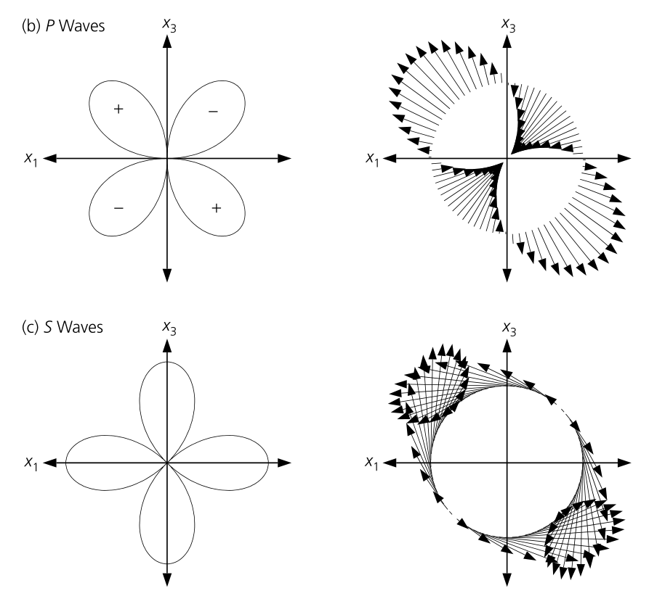
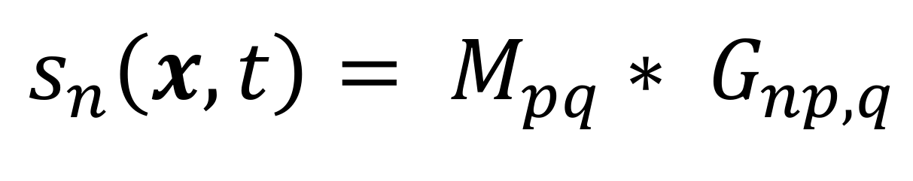
Pendahuluan dan Latar Belakang
Moment Tensor -> Gaya ekuivalen yang berasal dari sumber titik yang menghasilkan radiasi gelombang seismik yang sama dengan sumber dislokasi
Stein & Wysession (2003)

Slide 5
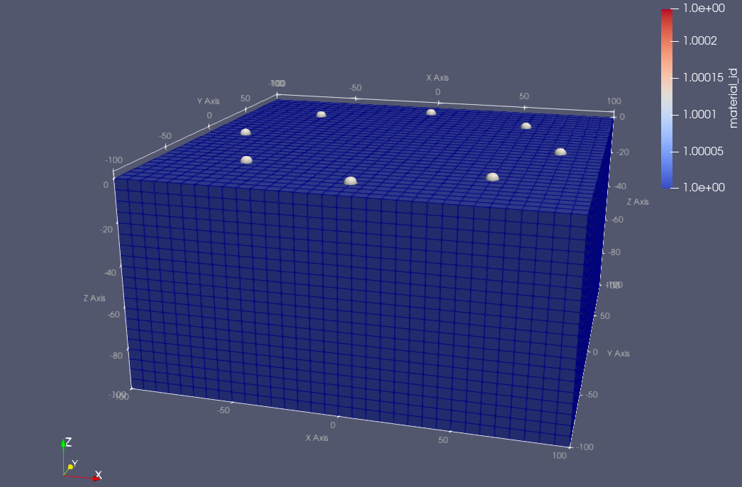
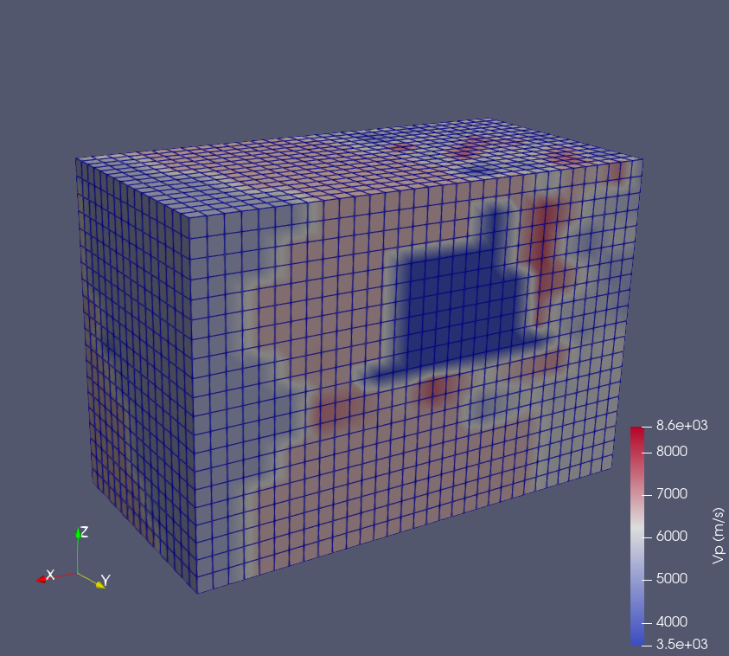
Pendahuluan dan Latar Belakang
Homogen
Heterogen

Slide 6
Pendahuluan dan Latar Belakang
Model
Tujuan:
Melakukan simulasi gelombang di medium 3-dimensi untuk mendapatkan data sintetik
Mendapatkan model parameter sumber yang optimal yang dilihat dari misfit antara waveform observasi dan simulasi yang minimum
Modifikasi parameter model
Forward Modeling
Tidak
Fit?
Sintetik
Data
Ya
Solusi terbaik
Grandis (2009)

Slide 7
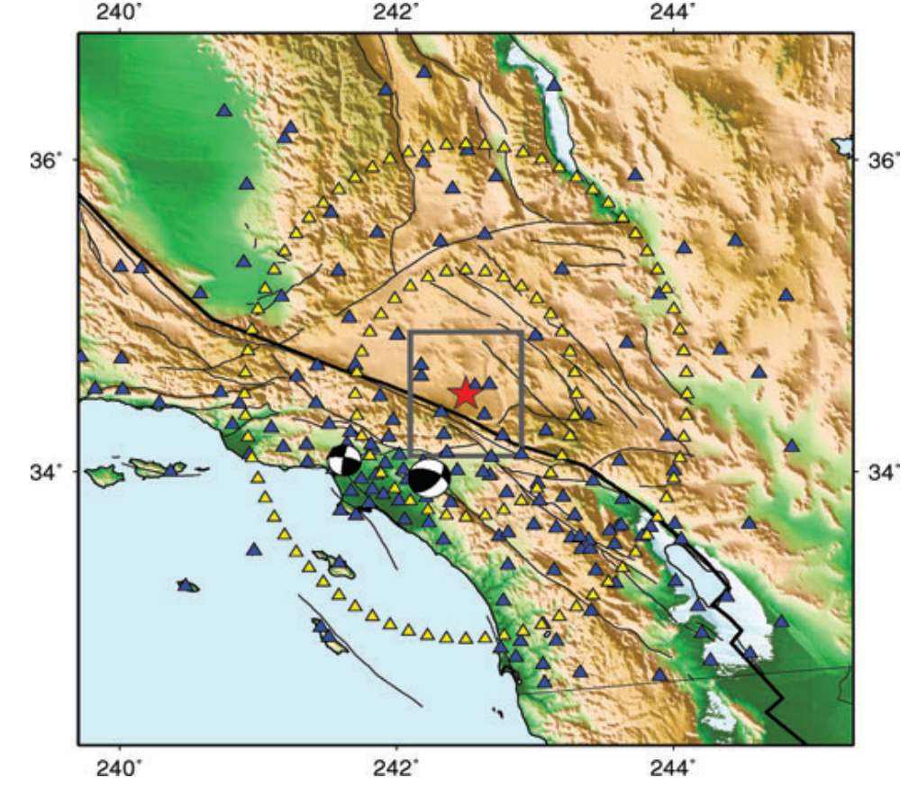
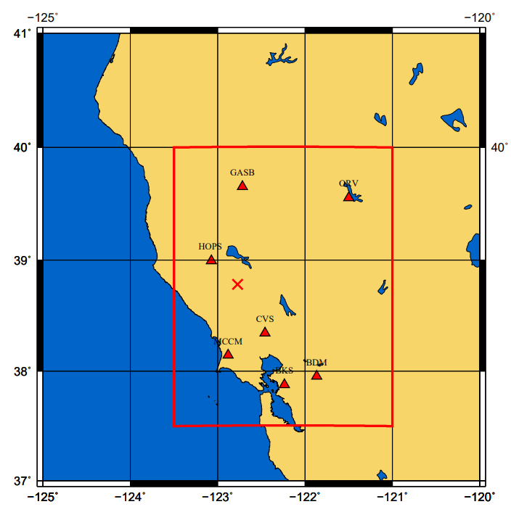
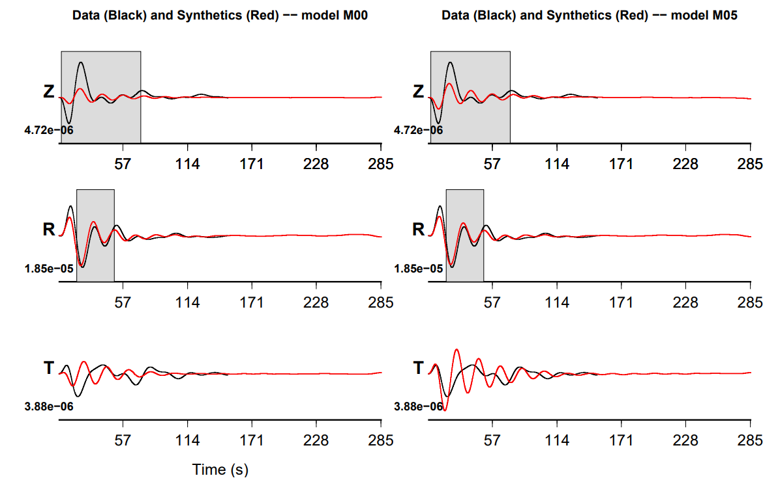
Pendahuluan dan Latar Belakang
Penelitian terdahulu
Penelitian ini
Southern California Earthquakes
Kim dkk. (2011)
Pertambangan bawah tanah
Variasi struktur kecepatan secara lateral
Gempa antropogenik
Geyser geothermal field,
Northern California
Morency, C., & Mellors, R. (2012)

Slide 8
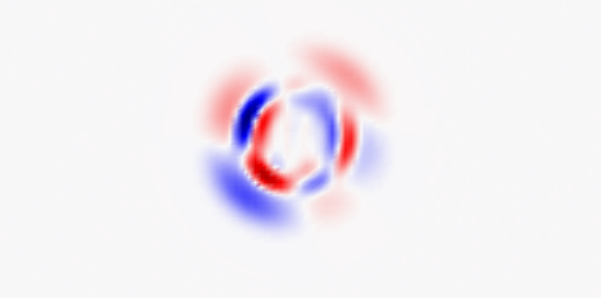
Simulasi Forward

Slide 9
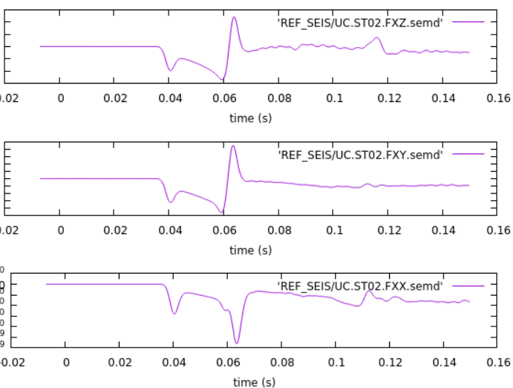
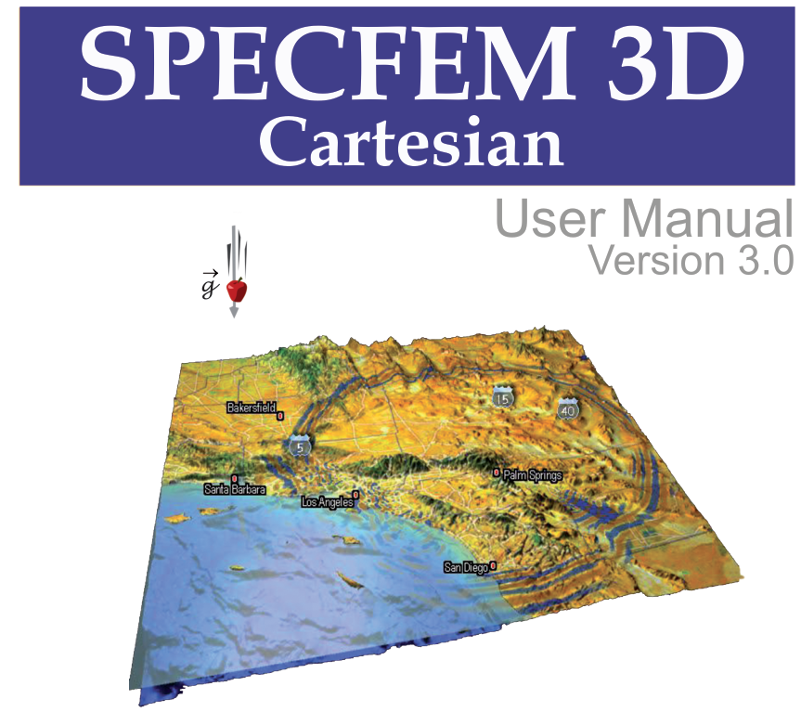

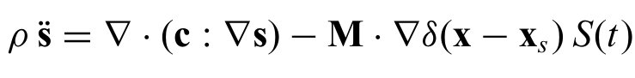
Green’s function di medium heterogen 3-dimensi
Numerical solver
(Spectral-element method)
Model :
Parameter sumber
Model struktur kecepatan dan densitas
Forward operator

Slide 10
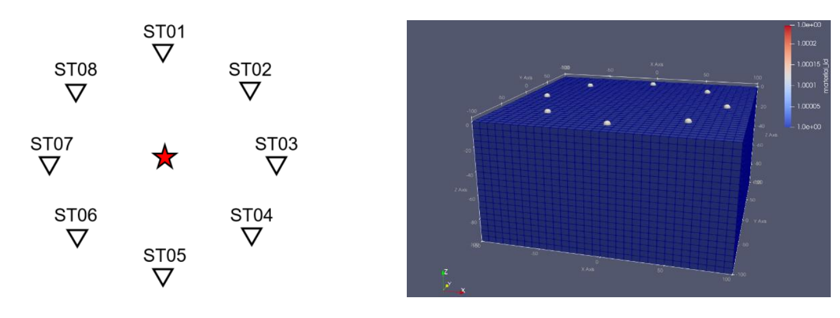
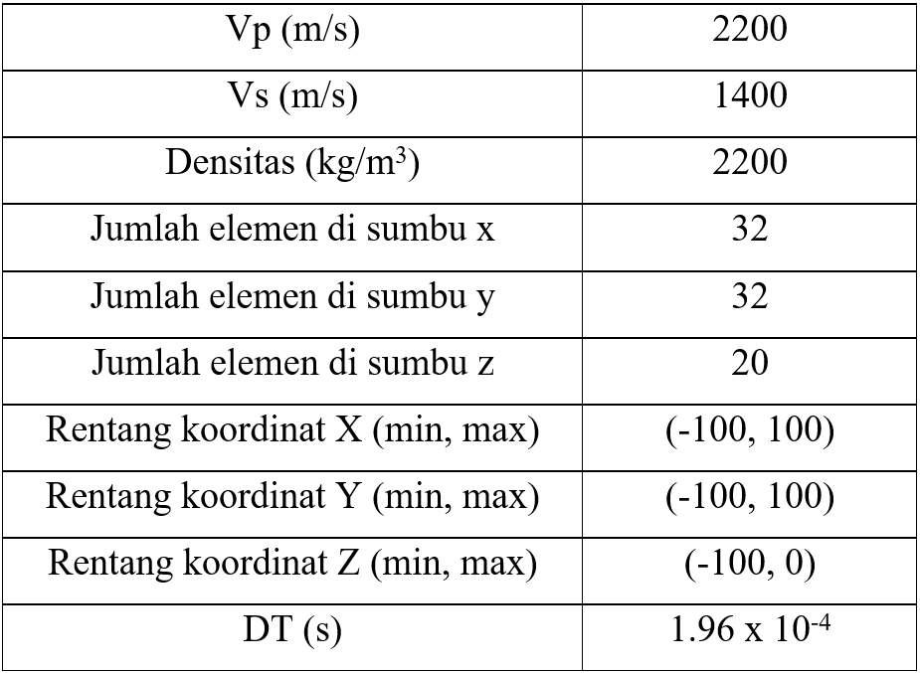
Parameter Simulasi
Geometri source-receiver
Grid 3 dimensi

Slide 11
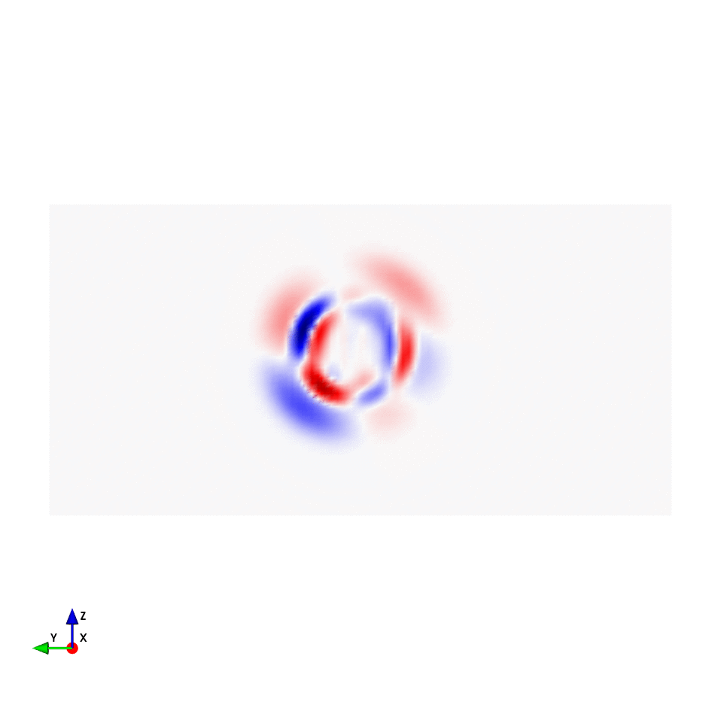
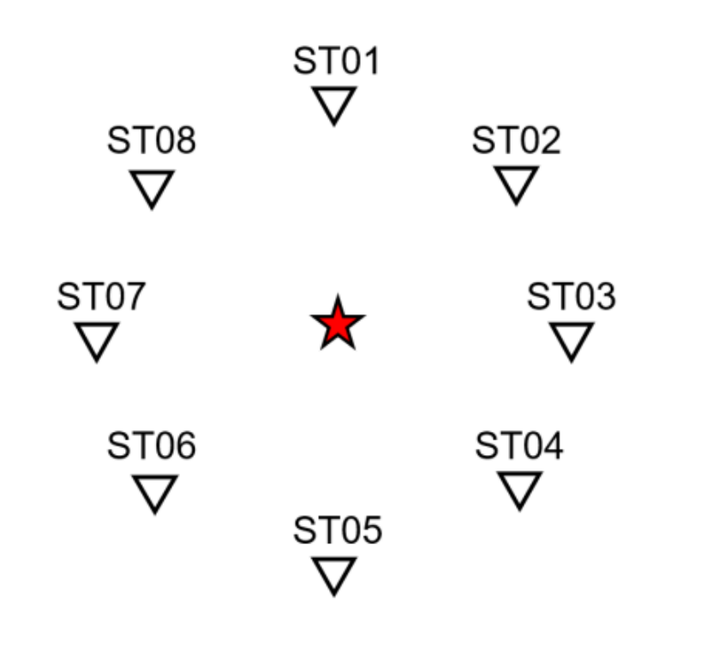
Forward Simulation
ST01
ST05
(komponen vertikal dari medan kecepatan)
dari t = 0.0196 s – 0.1568 s

Slide 12
Inversi dan Metode Adjoin

Slide 13
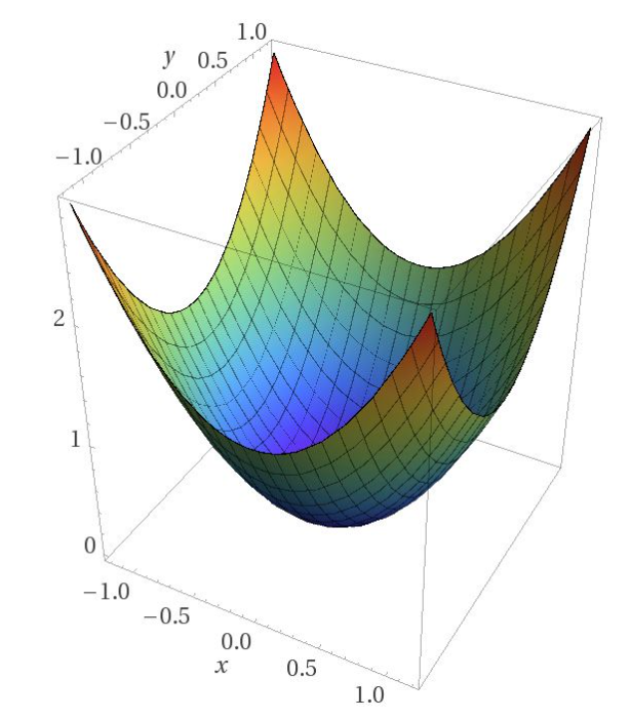
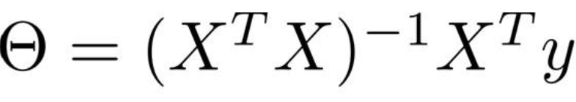

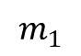
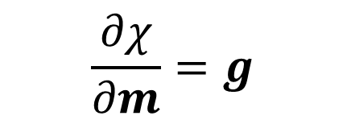
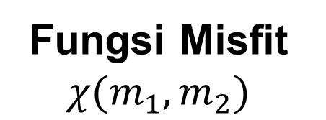
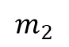
Metode Optimasi
Fungsi Misfit $χ(m_{1},m_{2})$
Gradient (steepest ascent)
-Gradient (steepest descent)
Inversi linear
$$m_{2}$$
$$m_{1}$$
$$\frac{∂χ}{∂m}=g$$
$$m^{i+1}=m^{i}−αg$$

Slide 14
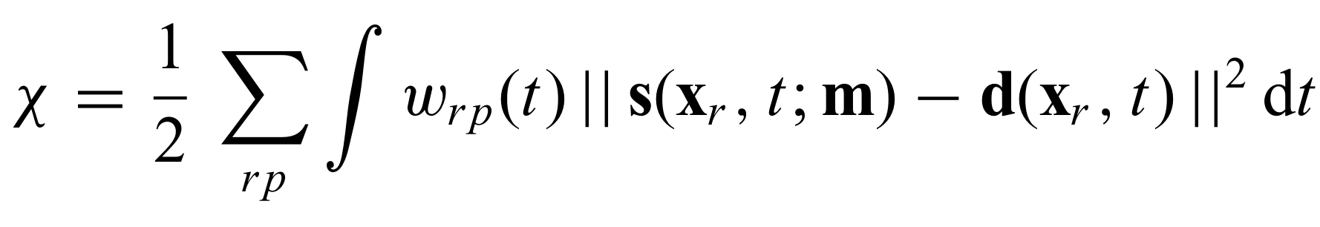
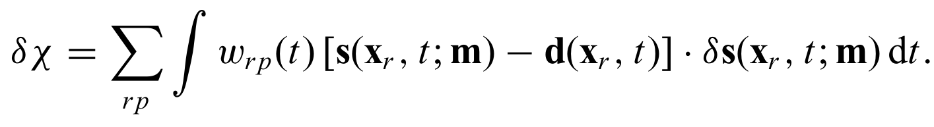
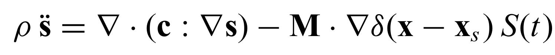
Fungsi misfit di full-waveform inversion
Waveform misfit :
Waveform sintetik
Waveform data
Gradien fungsi misfit
displacement
?
density
Elastic modulus
Source

Slide 15
Metode Adjoin
Metode untuk menghitung gradien/turunan dari fungsi misfit terhadap parameter model
Ambil variasi/turunan fungsi misfit terhadap parameter model
Sumber Adjoin
Simulasi Adjoin
Medan gelombang adjoin
Definisikan fungsi misfit

Slide 16
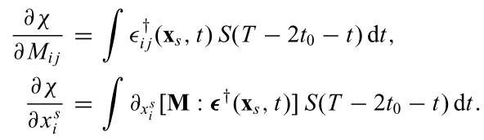
Metode Adjoin
Regular wave equation :
Adjoint wave equation :
regular wavefield
Moment tensor di posisi sumber
Adjoint wavefield
Sumber adjoin di posisi receiver
Kim (2011)

Slide 17

Adjoint Simulation
ST01
ST05
(komponen vertikal dari medan kecepatan)
dari t = 0.0196 s – 0.1568 s

Slide 18
Hasil dan Diskusi

Slide 19
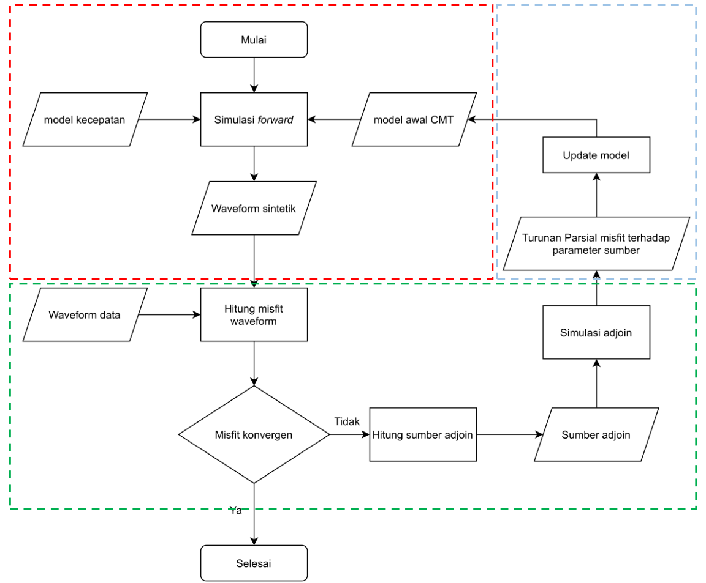
Alur Inversi
Model Update
Forward Simulation
Adjoint Simulation

Slide 20
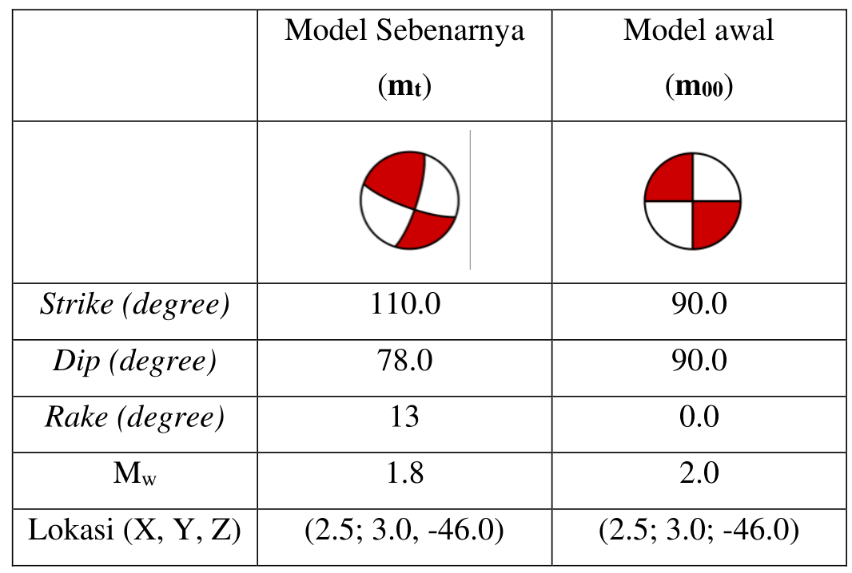
Inversi Momen Tensor 6 parameter

Slide 21
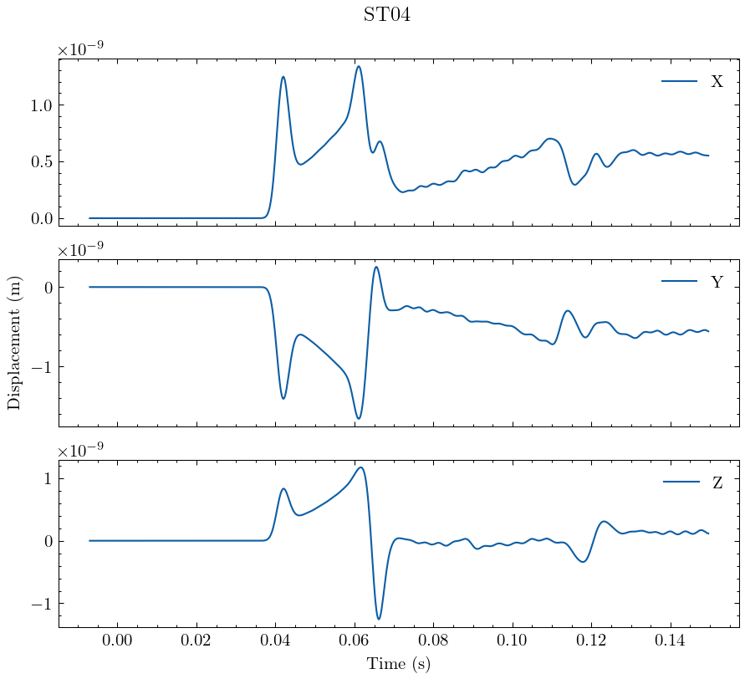
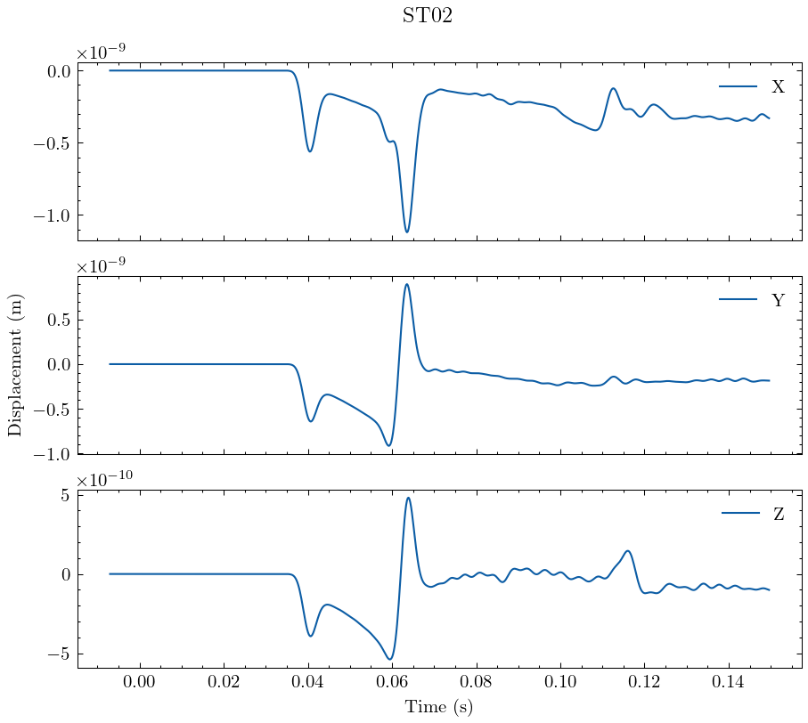
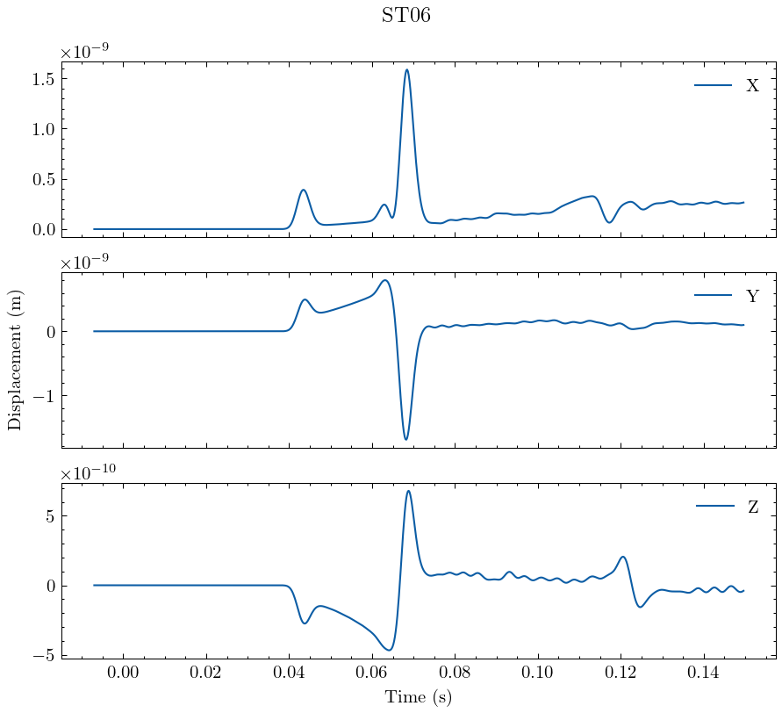
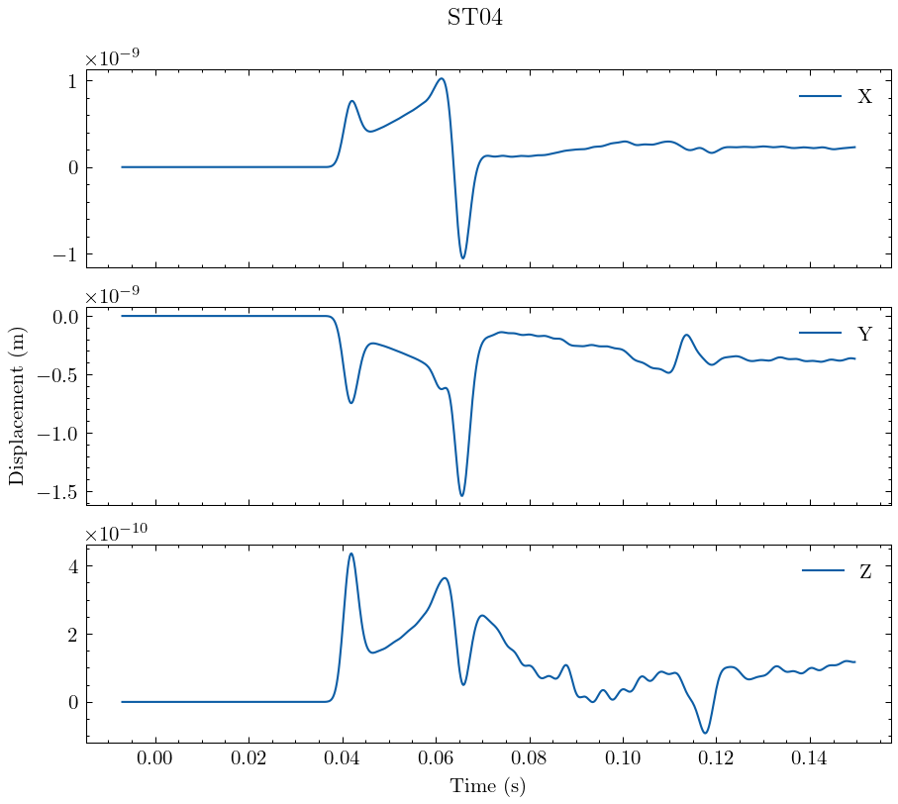
Seismogram hasil simulasi (True data)
ST08
ST02
ST06
ST04

Slide 22
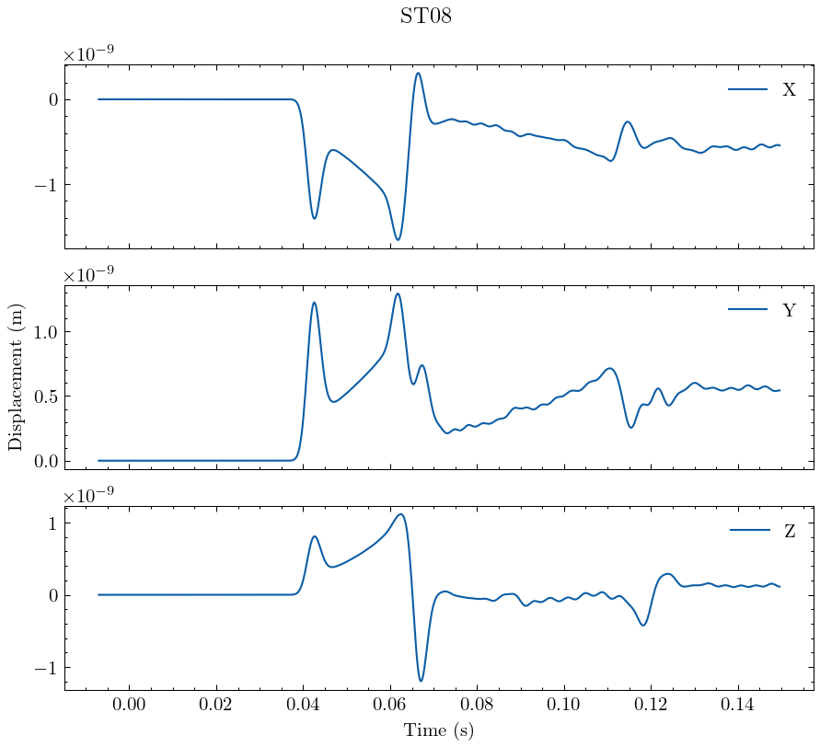
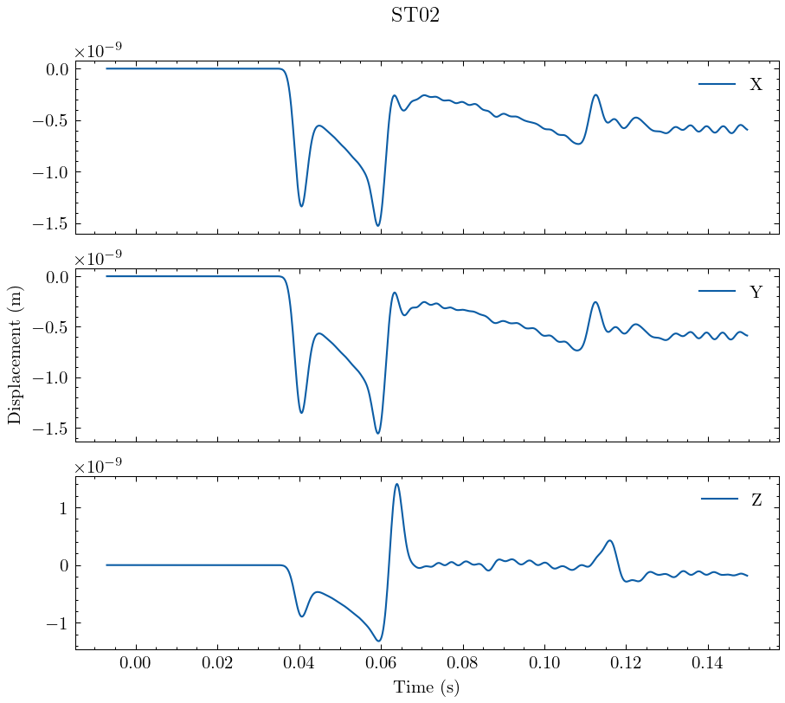
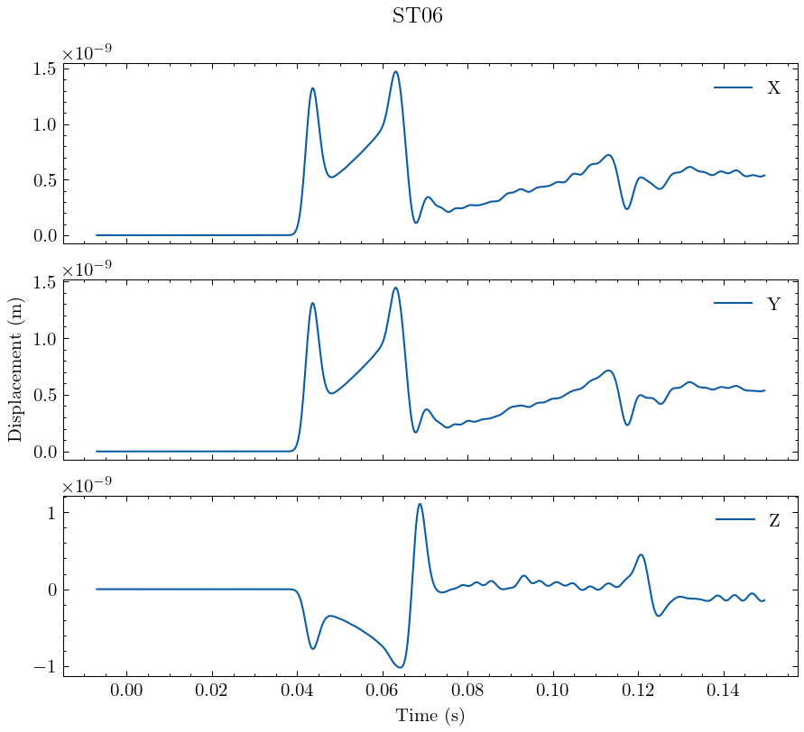
Seismogram hasil simulasi (Initial model)
ST08
ST02
ST06
ST04

Slide 23
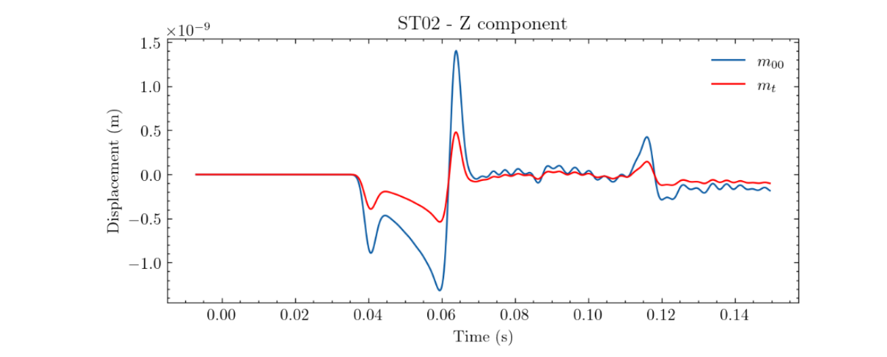
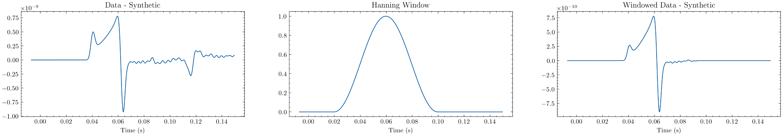
Sumber Adjoin

Slide 24
Sumber Adjoin

Slide 25
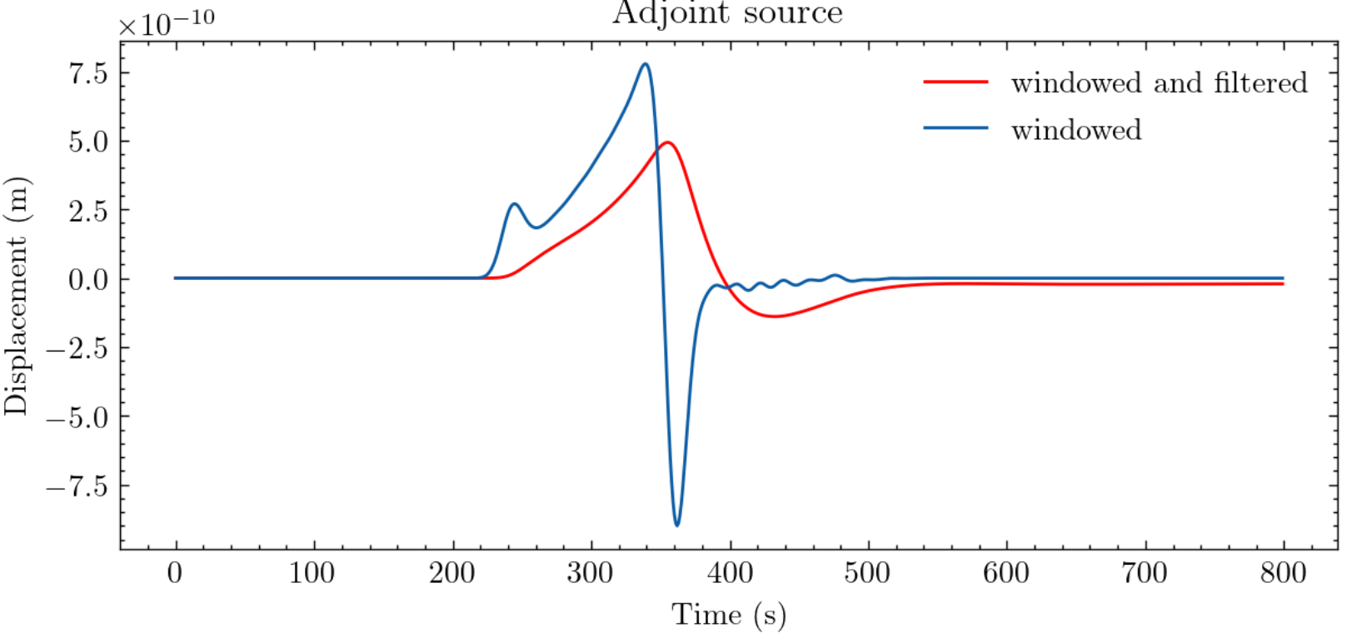
Sumber Adjoin
Low pass filter 30 Hz

Slide 26
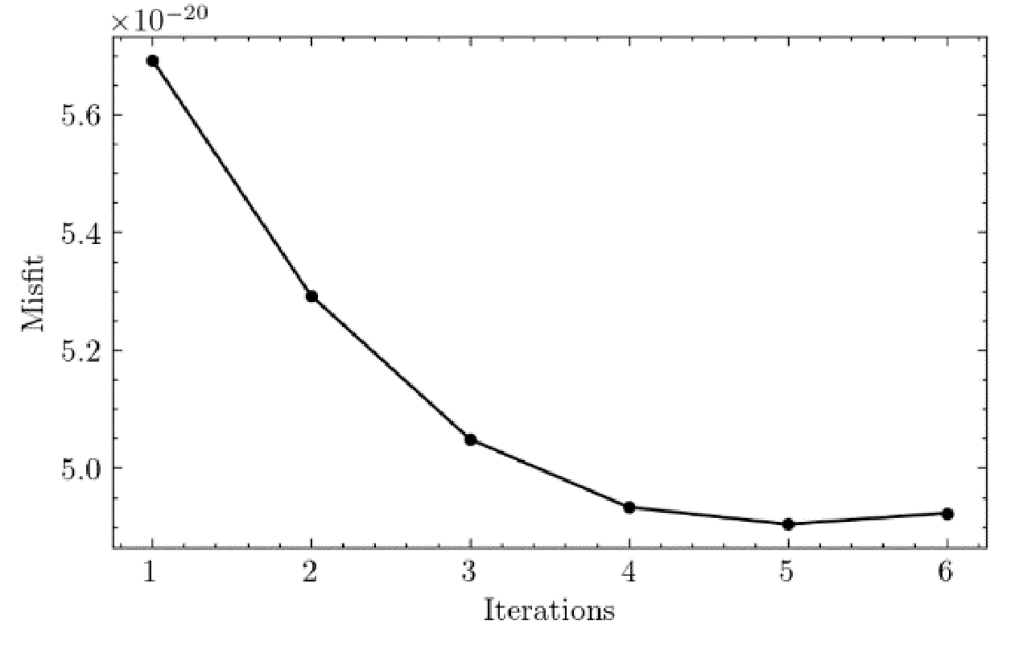
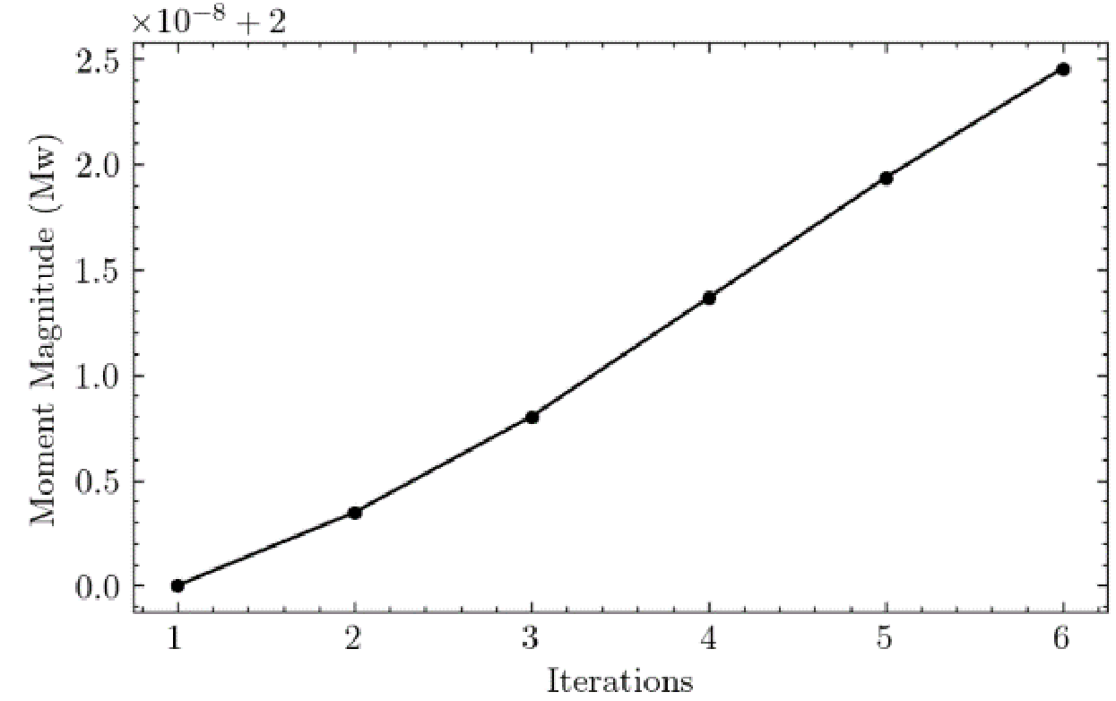
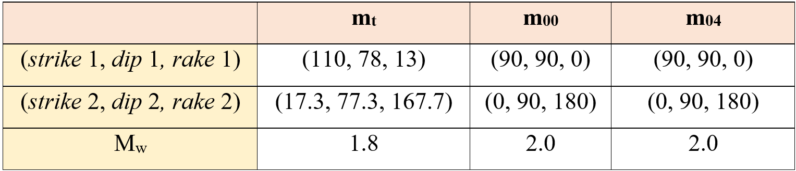
Misfit reduction

Slide 27
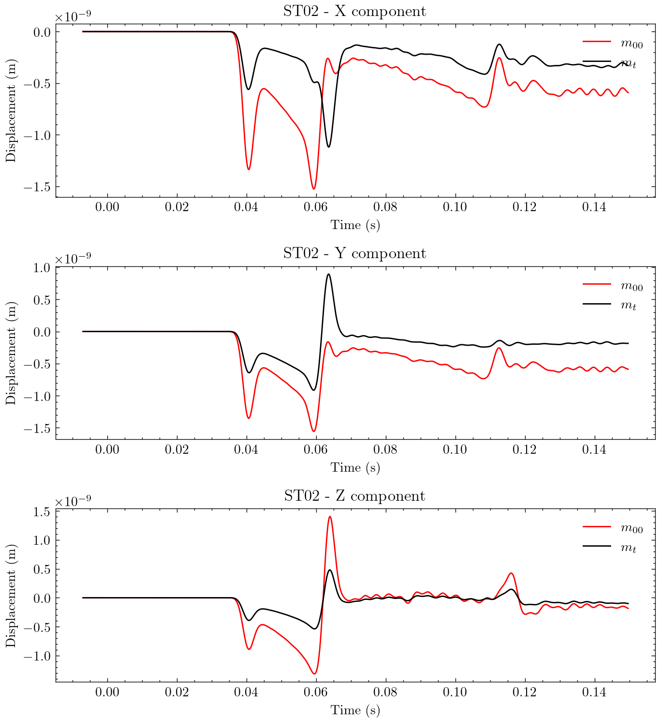
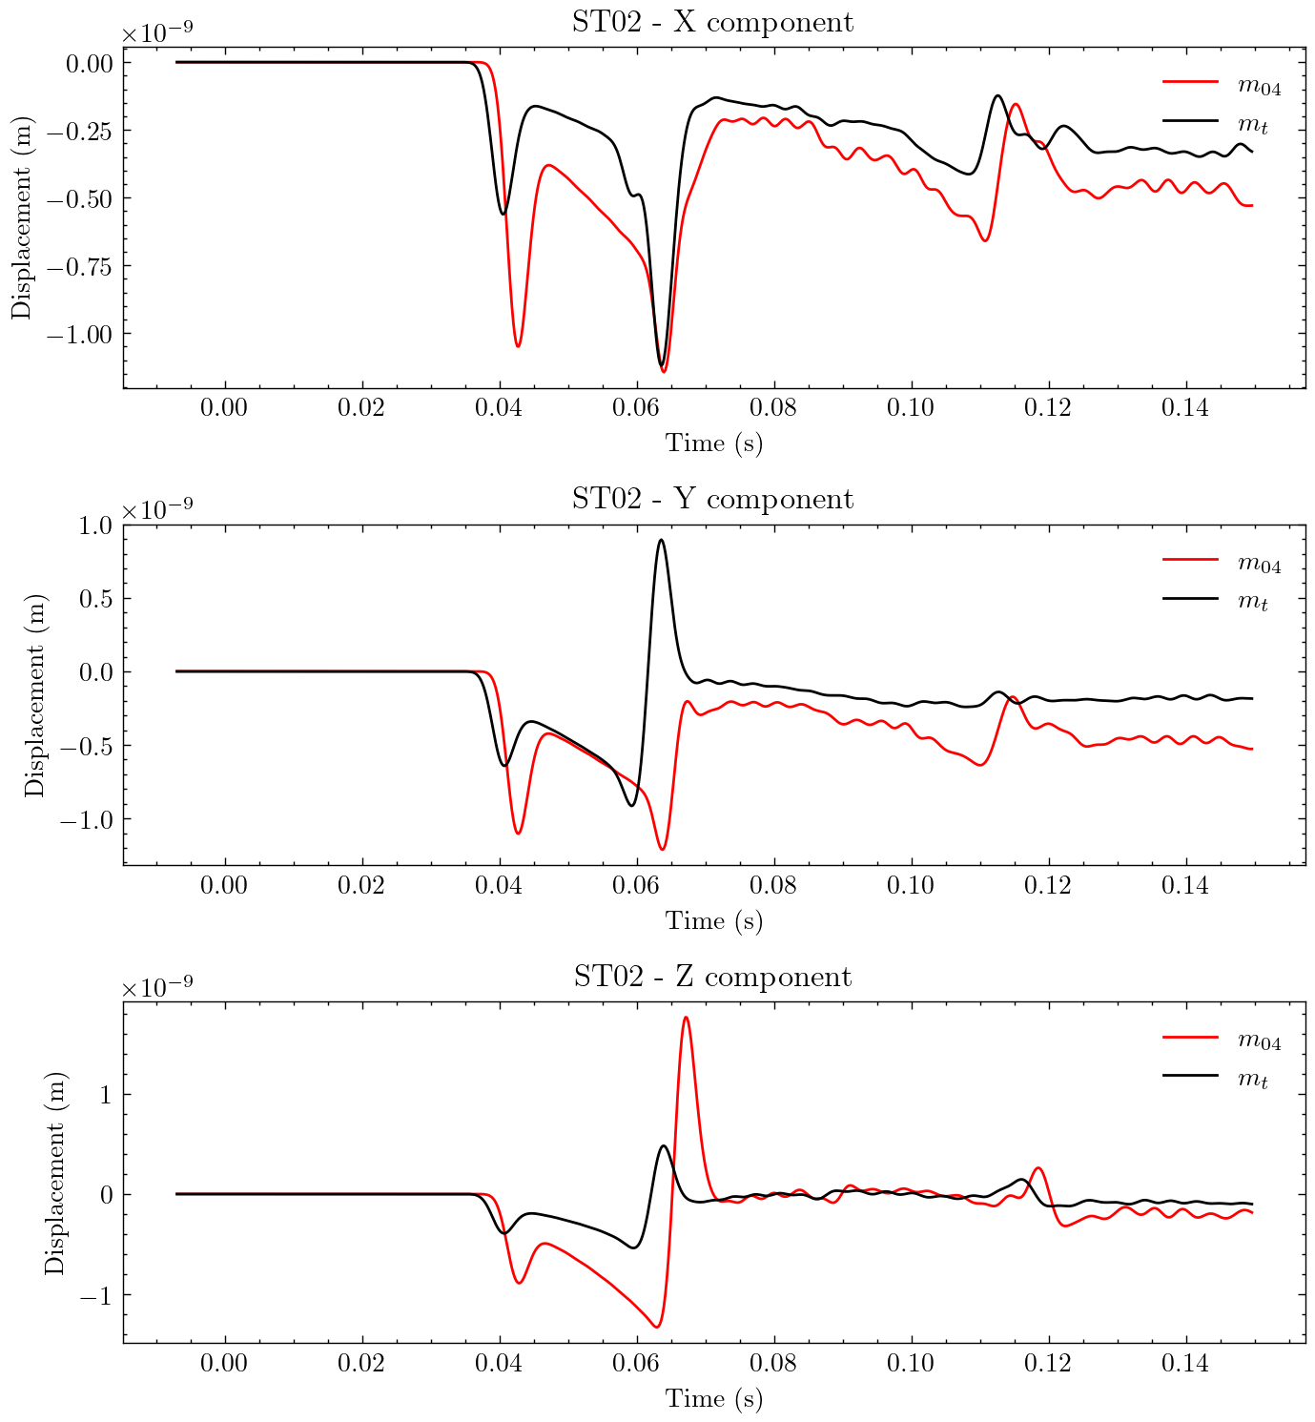
Waveform
Initial Model ; True Model
Best Model ; True Model

Slide 28
Diskusi
Skema iteratif untuk update model sudah berjalan dengan baik, namun model terbaik masih jauh dari model sebenarnya.
Terlihat ada time-shift dari hasil model terbaik, hasil ini mungkin terjadi akibat proses filtering di akhir langkah pembuatan simulasi adjoin.
Model tidak berubah terlalu jauh, diduga penyebabnya adalah kurangnya jumlah stasiun perekaman

Slide 29
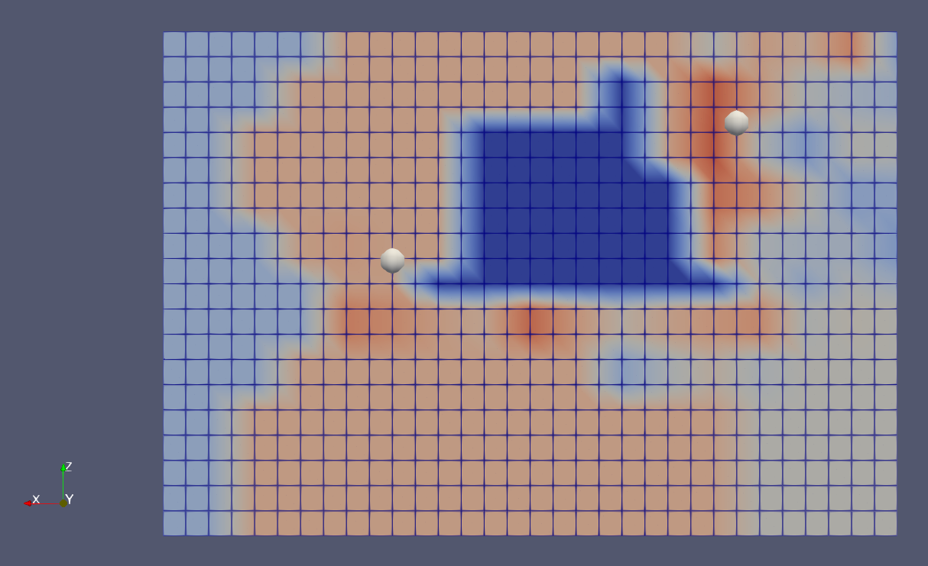
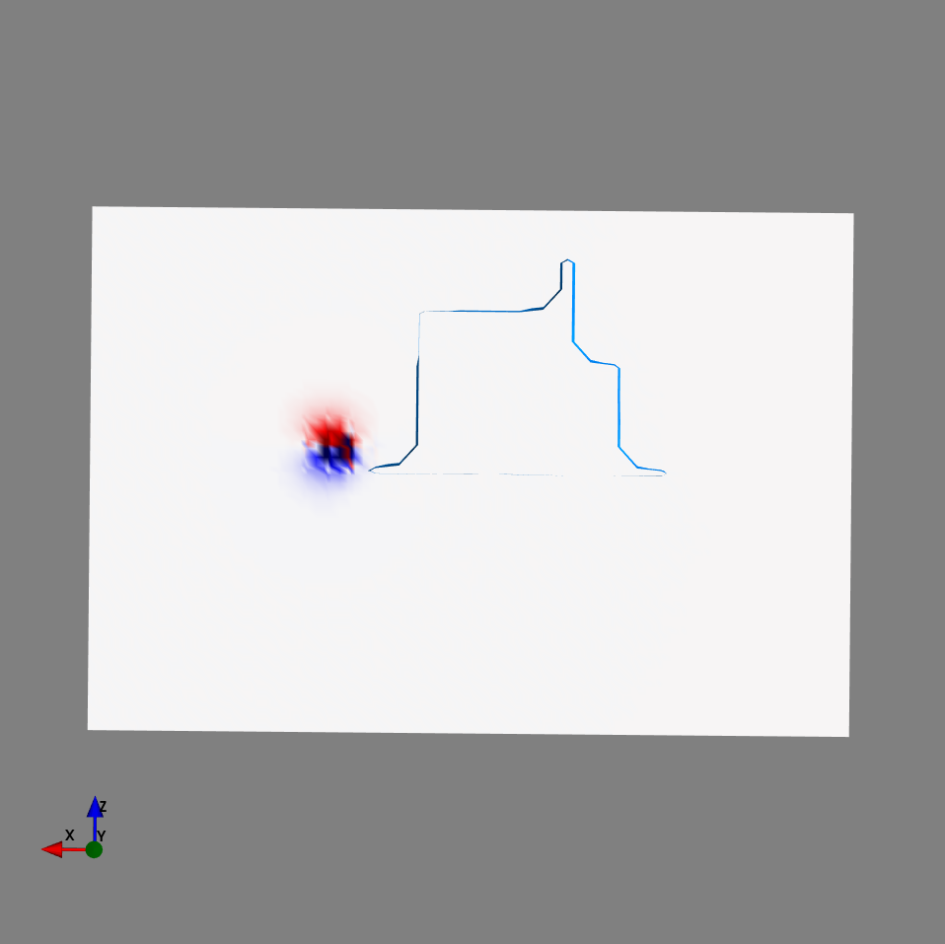
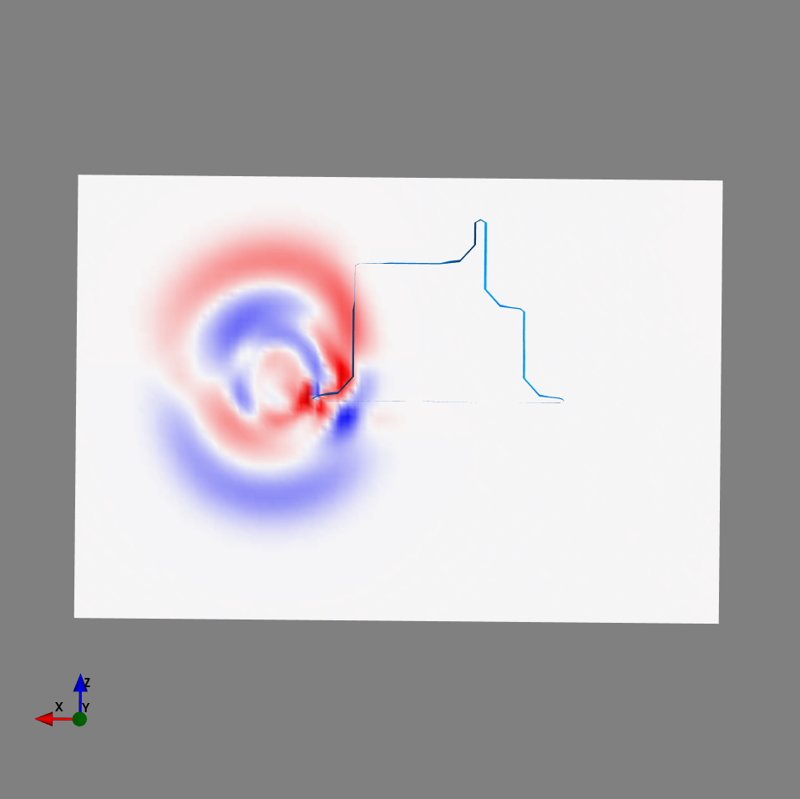
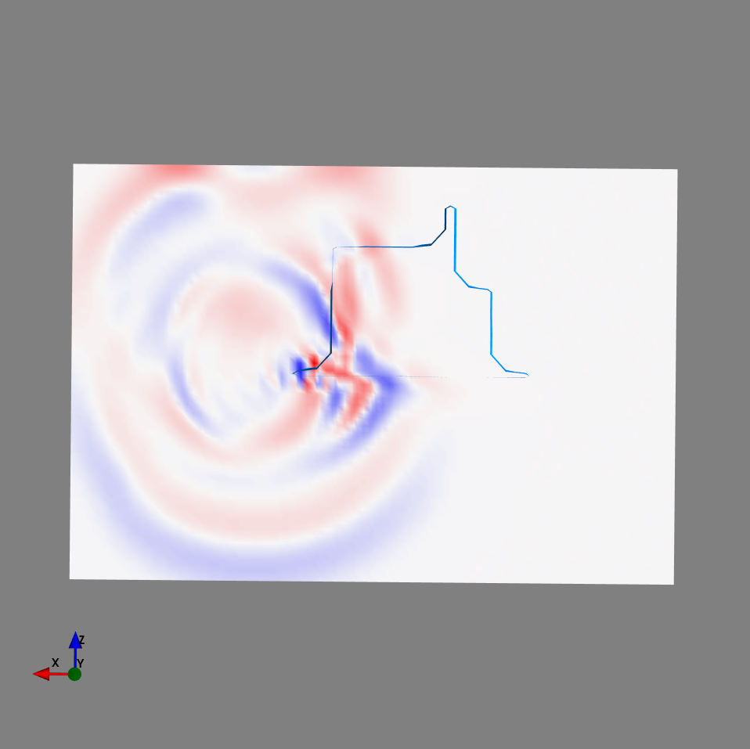
Rencana ke depan

Slide 30
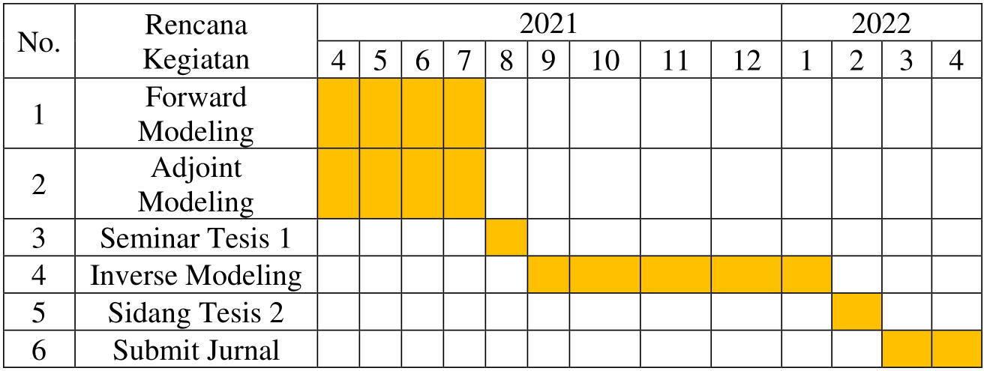
Jadwal Penelitian

Slide 31
Daftar Pustaka
Aki, K., & Richards, P. G. (2002): Quantitative Seismology. Sausalito, Calif : University Science Books.
Ambara P., IP Raditya. (2020): Analisis Evolusi Struktur Vp, Vs, dan Vp/Vs melalui Tomografi 4D pada Lapangan Pertambangan Bawah Tanah “UC”, Tesis Program Magister, Institut Teknologi Bandung.
Chodacki, J. (2020): Simulation of ground motion in a polish coal mine using spectral-element method. Journal of Seismology, 24(2), 363–373.
Fichtner, A. (2010): Full Seismic Waveform Modelling and Inversion (Advances in Geophysical and Environmental Mechanics and Mathematics) (2011th ed.).
Fletcher, R., (1987): Practical Methods of Optimization, 2nd edn, John Wiley & Sons, New York, NY
FP. (2018): Introduction to Microseismic in “UC” mine, internal report.
Gharti, H. N., Oye, V., Kühn, D., & Zhao, P. (2011): Simultaneous microearthquake location and moment‐tensor estimation using time‐reversal imaging. SEG Technical Program Expanded Abstracts 2011, 1632–1637.
Kawakatsu, H., & Montagner, J. P. (2008): Time-reversal seismic-source imaging and moment-tensor inversion. Geophysical Journal International, 175(2), 686–688.
Kim, Y., Liu, Q., & Tromp, J. (2011): Adjoint centroid-moment tensor inversions. Geophysical Journal International, 186(1), 264–278.
Komatitsch, D., & Tromp, J. (1999): Introduction to the spectral element method for three-dimensional seismic wave propagation. Geophysical Journal International, 139(3), 806–822.

Slide 32
Daftar Pustaka
Liu, Q. (2004): Spectral-Element Moment Tensor Inversions for Earthquakes in Southern California. Bulletin of the Seismological Society of America, 94(5), 1748–1761.
Modrak, R., & Tromp, J. (2016): Seismic waveform inversion best practices: regional, global and exploration test cases. Geophysical Journal International, 206(3), 1864–1889.
Morency, C., & Mellors, R. (2012): Full moment tensor and source location inversion based on full waveform adjoint inversion: application at the Geysers geothermal field. SEG Technical Program Expanded Abstracts.
Tape, C., Liu, Q., Maggi, A., & Tromp, J. (2010): Seismic tomography of the southern California crust based on spectral-element and adjoint methods. Geophysical Journal International, 180(1), 433–462.
Tape, C., Liu, Q. and Tromp, J. (2007), Finite-frequency tomography using adjoint methods—Methodology and examples using membrane surface waves. Geophysical Journal International, 168: 1105-1129.
Tromp, J., Tape, C., & Liu, Q. (2004): Seismic tomography, adjoint methods, time reversal and banana-doughnut kernels. Geophysical Journal International, 160(1), 195–216.

Slide 33
Terima Kasih

Slide 34
Backups

Slide 35
Adjoint simulation vs Forward simulation
Regular forward simulation
Solve wavefield
regular wavefield
Create seismic source
Adjoint simulation
Create adjoint source
Solve wavefield (receiver as virtual source)
Adjoint wavefield

Slide 36
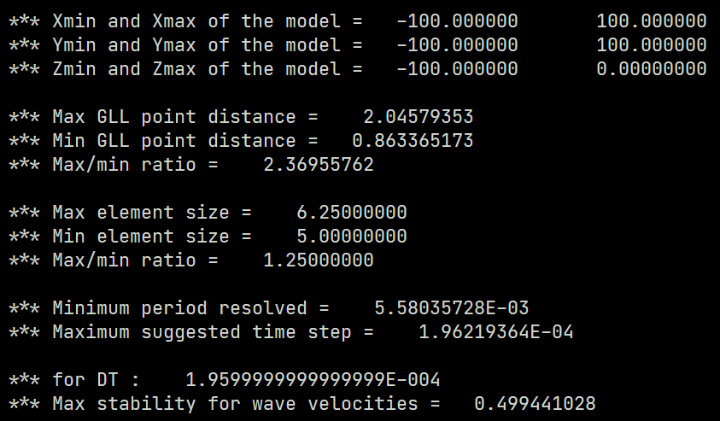

Slide 37
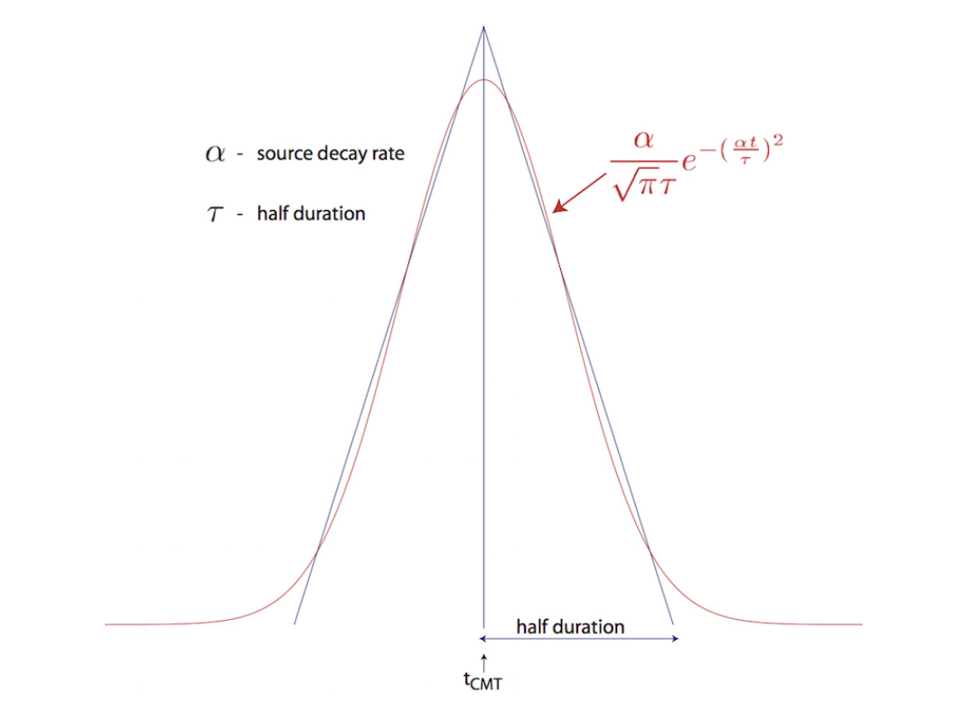

Slide 38
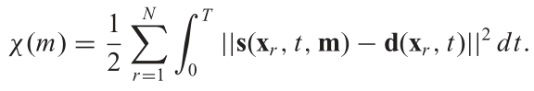





Waveform misfit - derivatives with respect to structural parameter
Synthetic
waveform
Actual waveform
Adjoint source

Slide 39



Waveform kernel

Slide 40










Adjoint method
1
Variation with respect to structural parameter
Variation with respect to source parameter
Adjoint source
Adjoint source
1
1

Slide 41






Adjoint Method philosophy

Slide 42








Slide 43




 | m_{t} | m₀₀ | m₀₃
(strike 1, dip 1, rake 1) | (110, 78, 13) | (90, 90, 0) | (104.1, 75,.6 21)
(strike 2, dip 2, rake 2) | (17.3, 77.3, 167.7) | (0, 90, 180) | (8.7, 69.7, 164.6)
Mw | 1.8 | 2.0 | 1.92
Initial seismogram vs Reference seismogram
Best model seismogram vs Reference seismogram

Slide 44
 | True Model : m_{t} | Initial model : m₀₀ | Best model : m₀₃
(strike 1, dip 1, rake 1) | (110, 78, 13) | (90, 90, 0) | (104.1, 75.6, 21)
(strike 2, dip 2, rake 2) | (17.3, 77.3, 167.7) | (0, 90, 180) | (8.7, 69.7, 164.6)
Mw | 1.8 | 2.0 | 1.92
Initial seismogram vs Reference seismogram
Best model seismogram vs Reference seismogram

Slide 45

Iteration 6

Slide 46


Slide 47


With PML
Without PML

